Slide 1
Module 05 ”Structured Exception Handling”

Slide 2
Agenda
Introducing Exceptions
Catching Exceptions
Throwing Exceptions
Defining Custom Exceptions

Slide 3
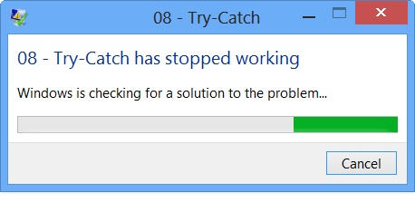
What are Exceptions?
Well…
Notes:
Normal program flow is handled by statements
Abnormal program flow is handled by exceptions

Slide 4
Why Exceptions?
int rc = 0;
Start:
rc = OpenFile( "Hello.txt" );
if( rc == -1 ) goto FileNotFound;
rc = GetFileContents();
if( rc == 87 ) goto FileEmpty;
rc = ConvertContents();
if( rc == 112 ) goto IllegalContents;
goto Succeeded;
FileNotFound: goto Start;
FileEmpty: goto Failed;
IllegalContents: goto Failed;
Succeeded: Console.WriteLine( "Yeah!" );
Failed: ...;
Notes:
Because Exception objects are the perfect object-oriented approach to structured error handling..! ☺
Traditional error handling is error-prone, impossible to maintain, …
Ask students what is wrong with this:
Mixes logic and error handling
Copying of code: “goto Failed”
Value of rc is not obvious
We can forget to check for a specific rc
Distinct info for each rc-value possible

Slide 5
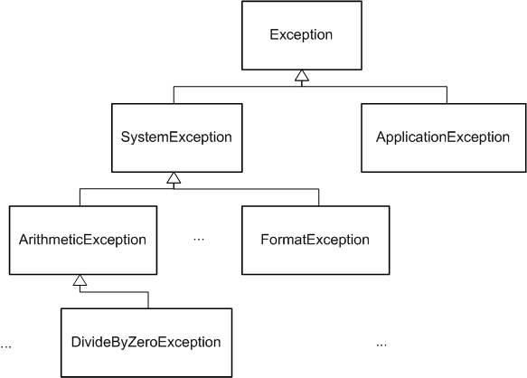

The Hierarchy of Exceptions
Notes:
Exceptions are objects structured in a well-defined hierarchy
There are many more exceptions than shown here (Use Help or Reflector)
Each relevant Exception object contains the extra info which is relevant for that particular error situation (constrasting the earlier traditional error handling)

Slide 6
Agenda
Introducing Exceptions
Catching Exceptions
Throwing Exceptions
Defining Custom Exceptions

Slide 7
The try-catch Construct
Perform application logic in a try-block
Deal with exceptions in a catch-block
The exception variable is scoped to the catch-block only
try
{
Console.WriteLine( "Enter a number: " );
int i = int.Parse( Console.ReadLine() );
Console.WriteLine( "You entered the number {0}", i );
}
catch( FormatException exception )
{
Console.WriteLine( exception );
}
Notes:
This separates Application Logic and Error Handling (constrasting traditional handling)
Explain semantics in detail
Run in Visual Studio 2012. See normal result. Run again and see abnormal result.
Set breakpoint in Visual Studio 2012 to illustrate
Setting the scene for the slides to come, enter a humongously large number and get an OverflowException! This misses the handling altogether and sets the scene for discussing call stack etc.

Slide 8

Understanding Exceptions: The Call Stack
static void Main()
{
A();
}
static void A()
{
B();
}
static void B()
{
C();
}
static void C()
{
Console.Write(" In C" );
}
Program.C()
Line 21
Program.B()
Line 17
Program.A()
Line 13
Program.Main()
Line 9
Call Stack
Notes:
The runtime maintains a stack of active method calls
Explain how this call stack grows and shrinks
Show “Debug” -> “Windows” -> “Call Stack” in Visual Studio 2012 and show program execution.
Introduce a try-catch block in B() handling the exception.
Ask students what they will see in the console window.

Slide 9
Core Members of System.Exception
Name | Characteristics
Data | Additional data in the shape of key/value pairs
HelpLink | URL to file or website
InnerException | Previous exceptions
Message | Textual description
Source | Name of assembly throwing the exception
StackTrace | Call stack
TargetSite | Details of the method throwing the exception
Notes:
This is some – but not all – of the central members of System.Exception
ToString() provides a readable representation

Slide 10
Multiple catch-blocks
Multiple catch-blocks can be applied when distinct types of exceptions need to be treated
Blocks must be ordered from most specific first to most general last
Only catch exceptions that you can do something about…
try
{
Console.WriteLine( "Enter a number: " );
int i = int.Parse( Console.ReadLine() );
Console.WriteLine( "You entered the number {0}", i );
}
catch( OverflowException caught ) { ... }
catch( FormatException exception ) { ... }
Notes:
Run the example program of Slide08 and enter a the large number again…
Experiment with inserting “catch( Exception exception )” first and last to see the results

Slide 11
The Generic catch
A generic catch-block anonymously catches all exceptions
This is equivalent to
try
{
Console.WriteLine( "Enter a number: " );
int i = int.Parse( Console.ReadLine() );
Console.WriteLine( "You entered the number {0}", i );
}
catch
{
Console.WriteLine( "Something went haywire..!" );
}
catch( Exception exception )
{
Console.WriteLine( "Something went haywire..!" );
}
Notes:
Except for the compiler warning! ;-)
(You might consider inserting it manually in the example code of the previous slide)
Only catch exceptions that you can do something about!!!

Slide 12
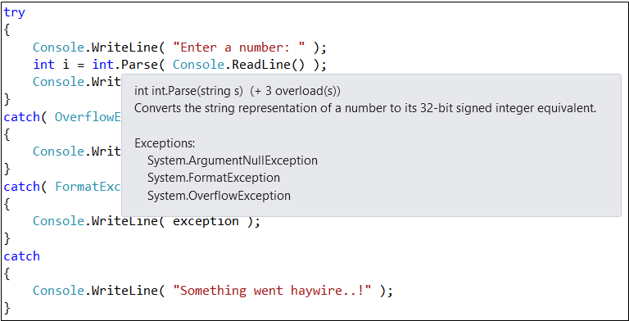
Which Classes Throw Which Exceptions?
Notes:
Good question! ☺
There is really no good way doing this.
Consult the help and IntelliSense!
A lot of classes throw exceptions. Also really innocent-looking ones such as Console.WriteLine(). (Check out the help for this!)

Slide 13
Visual Studio is Your Friend
Use the tools of Visual Studio to both inspect, detect, and prevent exceptions!
Use the Exception Window to break when certain exceptions are thrown
Locate this at “Debug” -> “Exceptions…”
Step through the code with F5, F10, F11
Set breakpoints to pause execution at specific points
These can be parameterized by conditions
The items at the bottom of the “Debug” menu
You can even change values
Note: Visual Studio treats exceptions in two different ways
With debugger: Breaks at original exception location
Without debugger: Displays OS’s exception dialog

Slide 14
Agenda
Introducing Exceptions
Catching Exceptions
Throwing Exceptions
Defining Custom Exceptions

Slide 15
The throw Keyword
It is possible to directly throw exceptions via the throw keyword
Console.WriteLine( "Enter a number: " );
int i = int.Parse( Console.ReadLine() );
Console.WriteLine( "Enter another number: " );
int j = int.Parse( Console.ReadLine() );
if( i == j )
{
throw new ArgumentException( "Identical numbers entered!" );
}

Slide 16
Re-throwing Exceptions
try
{
Console.WriteLine( "Enter a number: " );
int i = int.Parse( Console.ReadLine() );
Console.WriteLine( "You entered the number {0}", i );
}
catch( OverflowException )
{
Console.WriteLine( "Cannot deal with overflow here! :-(" );
throw;
}
The variable in the catch can be omitted if not used
Exam tip:
The difference between throw and throw exception is the call stack!
Notes:
Careful! Remember to rethrow! If you cannot do anything about the exception here, it is better to not catch it at all!
Only catch exceptions that you can do something about!!!

Slide 17
The finally-block
The statements in a finally block are always executed – even in the presence of exceptions!
The catch blocks are optional when there is a finally-block
SqlConnection connection = new SqlConnection();
try
{
connection.Open();
}
finally
{
connection.Close();
}
Notes:
This is excellent for Monitor, database connections etc.
The code might throw an exception and – still – everything gets cleaned up properly
Show accompanying example and let the students guess about the outcome (Even when “return” is added!)
Limitation: Control cannot be transferred out of the finally block!

Slide 18
Quiz: try-catch-finally
try
{
Console.WriteLine( "try" );
throw new Exception();
}
catch( Exception )
{
Console.WriteLine( "catch" );
return;
}
finally
{
Console.WriteLine( "finally" );
}

Slide 19
Agenda
Introducing Exceptions
Catching Exceptions
Throwing Exceptions
Defining Custom Exceptions

Slide 20
A Custom Exception Class
You can easily create your own custom exceptions
public class TicketSalesException : Exception
{
public TicketSalesException()
{
}
public TicketSalesException( string message ) : base( message )
{
}
public TicketSalesException( string message, Exception inner )
: base( message, inner )
{
}
}
Notes:
Custom exception classes should be public
Custom exception classes should define the three “standard” constructors
See extended example with more info

Slide 21
Inner Exceptions
If specified, the InnerException property supplies the original exception
In fact, the exception given by InnerException may in turn have inner exceptions.
try
{
Console.WriteLine( "{0} was just requested", EnterTickets() );
}
catch( TicketSalesException e )
{
Console.WriteLine( e );
if( e.InnerException != null )
{
Console.WriteLine( "Technical info: " + e.InnerException );
}
}

Slide 22
Best Practices for Exceptions
Use exceptions only for exceptional cases
Only catch exceptions you can handle
Don’t let any exceptions slip out of your program or component
Create an exception filter!
Throw exception objects of a type as specific as possible
Never throw a generic Exception
Make your own exception classes public
Implement the three “standard” constructors (*)
The “Exception/ApplicationException” Controversy
Notes:
(*) This is just part of the truth. All exceptions should be serializable, so the ISerializable constructors should be there as well. But this is beyond our scope here!
People don’t agree about whether to subclass ApplicationException or Exception directly

Slide 23
Summary
Introducing Exceptions
Catching Exceptions
Throwing Exceptions
Defining Custom Exceptions

Slide 24
Question
You are developing a program using structured exception handling. Your application defines a class called Logger containing the following method.
You need to ensure that
All exceptions are logged using Logger.LogToFile()
Exceptions are rethrown using the entire call stack.
Which code fragment should you use?
public static class Logger
{
public static void LogToFile( Exception exception ) { ... }
}

Slide 25
Question (Cont’d)
catch( Exception e ) { Logger.LogToFile( e ); throw e; }
catch( Exception e ) { Logger.LogToFile( e ); throw; }
catch { Exception e = new Exception(); Logger.LogToFile( e ); }
catch { Exception e = new Exception(); throw e; }

